Slide 1
Module 11 - Spacy
NLP Pipelines

Slide 2
Agenda
NLP via spacy in python!
I am going to use Colab for this session. Some of the tools didn’t behave as I expected in VS Code
Named Entity Recognition
Custom NER via spacy and label studio
Data annotation is a necessary task in practice!

Slide 3
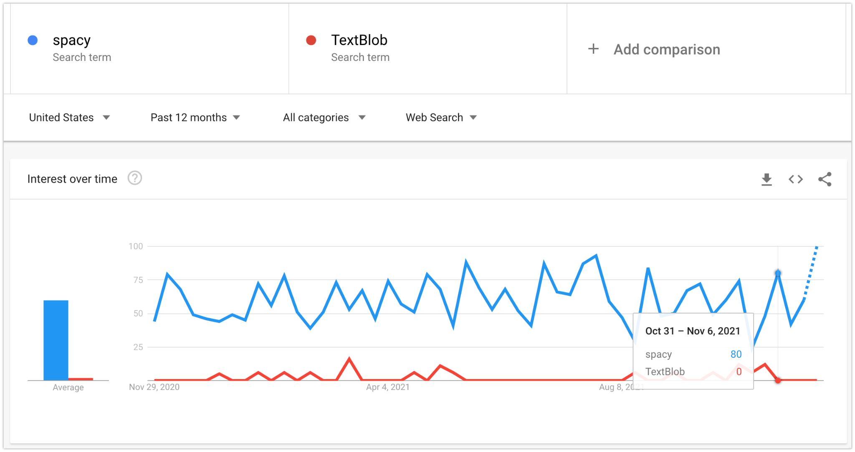
Google trends

Slide 4
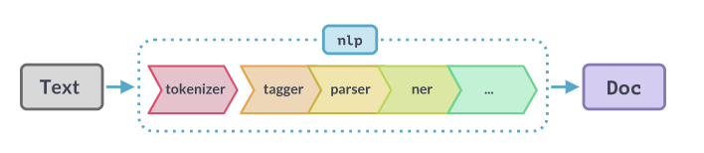
spaCy - NLP pipelines

Slide 5
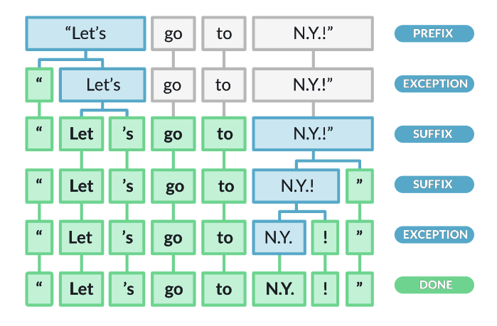
Tokenization - more than just a regex

Slide 6
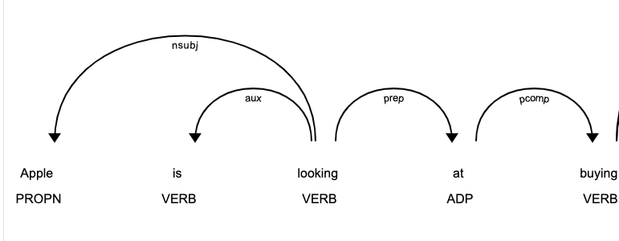
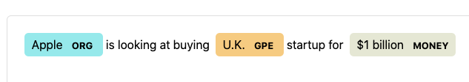
Visualization tools included

Slide 7
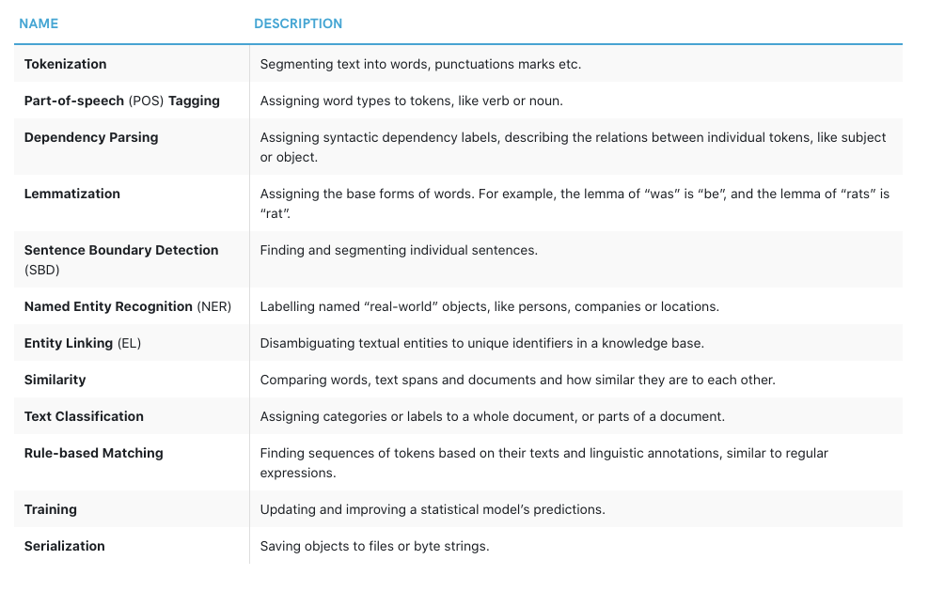
Robust (framework)

Slide 8


